Slide 1
Selenium Automation Framework
Vaibhav | 30th March 2020
Pune

Slide 2
Agenda
Framework Introduction
Selenium Introduction
Pros and Cons of Selenium
Tool Used
Code Structure
Design Approach
Samples of multiple type classes
Framework Architecture
Framework Setup
Logging and Reporting
Synchronization technique
Configuration
Encryption Techniques
SVN (Version Controlling) and Directory structure
Agile (Scrum) Adoptability
Continuous Integration
Demo / Q&A

Slide 3
Framework Introduction
The aim of this presentation is to review the new framework which has been developed using “Selenium + Java” for automation testing of Web Application , Android/iOS application automation using Appium and Window Native application automation using Window Application driver.
One framework design for all type of applications
Easy maintenance due to its design.
Proper categorization of suites.
High re-usability and no duplicate codes.
Less execution time. Easier for the testers to execute the code
Ease in locating and performing action on web elements.
Support continuous integration.

Slide 4
Selenium Introduction
What is selenium? Why is it used?

Slide 5
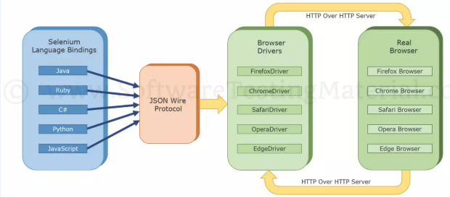
Selenium
Selenium is a suite of testing automation tools used for Web-Base applications: Selenium IDE, Selenium RC, Selenium Web Driver and Selenium Grid
These tools provide a rich set of testing functions specifically geared to varied testing scenarios of all types of Web applications
The operations provided by these tools are highly flexible and afford many options for comparing UI elements to expected application behavior.
Selenium tests can be executed on multiple browser platforms
Selenium WebDriver:
It is a successor of Selenium RC. It does the same job, but in a different way: instead of injecting a JavaScript code into the browser to simulate user actions, it uses the browser’s native support for automation (different for each browser). Also, instead of a dictionary-based API (used in Selenium RC), it offers the more convenient object-oriented API.
What it Does: it automates browsers.

Slide 6
Pro/Cons of Selenium:
Advantages:
Open source and wide community support
Option to choose Programming Language
Same Test Script can run on Multiple Web Browsers
Cost Efficient
Run multiple tests at a time. (Grid)
Supports all Operating Systems.
Disadvantages:
Expertise Required in a Particular Programming Language
Provides only partial support for dialog boxes
Being an open source, Selenium has no official technical support.

Slide 7
Tools Used

Slide 8
Tools/Components:
Language of choice: Java(1.8)
IDE of choice : Eclipse
Object Identification - Developer Toolbar
Key API - Selenium WebDriver(3.141.59)
Unit Testing Framework - TestNG
Build Management – Maven (Apache)
Code Management - Subversion(SVN) or GIT(Recommended)

Slide 9
Code Structure
Hybrid Approach
Keyword Based Testing
Data Driven Testing
Design Approach

Slide 10
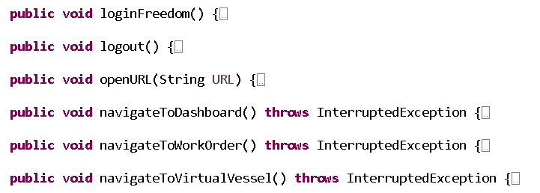
Keyword-Based Testing
Keyword-driven testing is a type of functional automation testing framework which is also known as table-driven testing or action word-based testing.
Benefits:
Enables writing tests in a more abstract manner using this approach.
Keyword driven testing allows automation to be started earlier in development cycle even before a stable build is delivered for testing.
There is a high degree of reusability

Slide 11
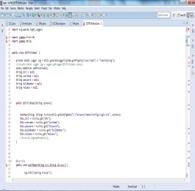
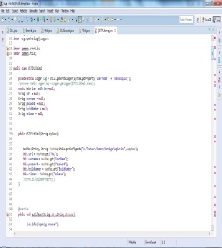
Keyword-Based Testing (cont.)
Keyword abstraction
SCRIPT
A method in a steps class (library) is the best way to represent a keyword, hide the complexity of test automation, and develop maintainable and reliable automation.
SCRIPT
SCRIPT
Functions are also re-usable. When an application changes, we only need to change the automation code in one place – the library.
SCRIPT
SCRIPT
STEPS
As more scripts are added, they can leverage debugged, reliable functions in libraries.
SCRIPT
SCRIPT
SCRIPT

Slide 12
Data Driven Testing (DDT)
It is a test automation framework that stores test data in a table or spreadsheet format.
This allows same test script to be executed for different combinations of input test data and generate test results.
In this framework, input values are read from data files and are stored into a variable(LinkedHashMap) in test scripts. DDT enables building both positive and negative test cases into a single test.
Using TestNG data provider class to pass test data to test script.

Slide 13
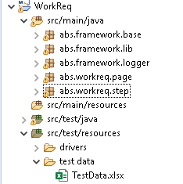
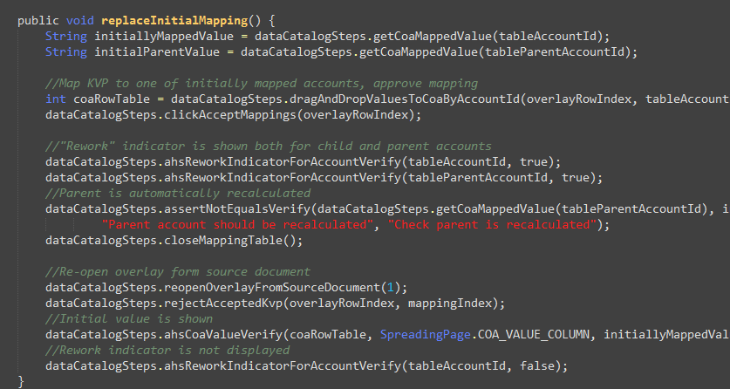
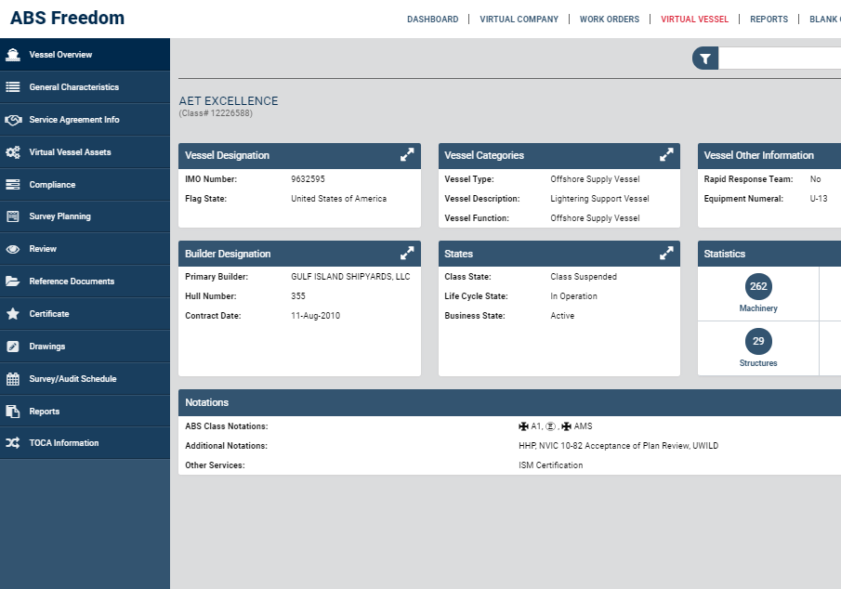

Data Driven Testing Flow
Execute test
Script
AUT
Read data set

Slide 14
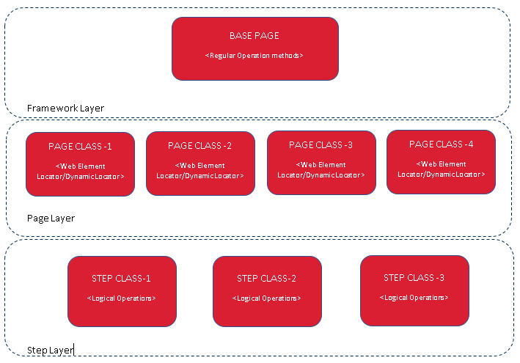
Design Approach
Page Object Model
Base Page layer includes regular operation methods like scrolling/clicking/synchronization.
Page classes includes locator(Xpath / Css) and dynamic xpath methods)
Step classes are actual meaningful methods (Test steps –login/navigation/searching)
Steps classes are actual functional library which includes reusable functions

Slide 15
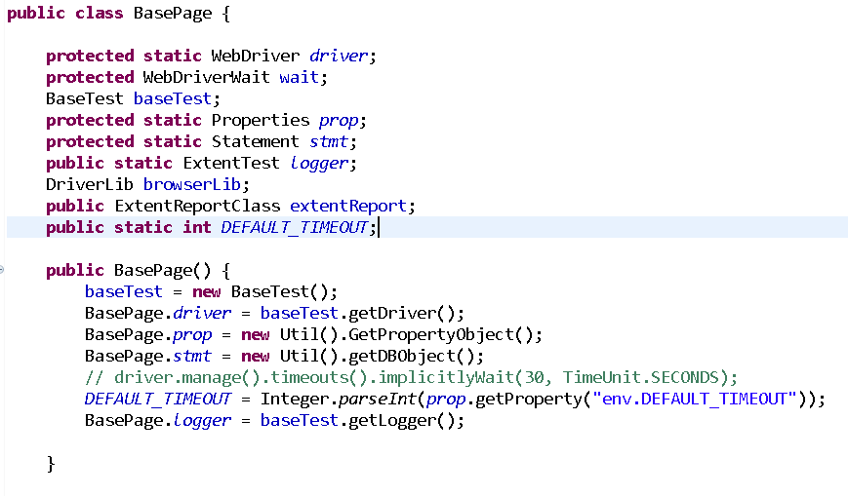
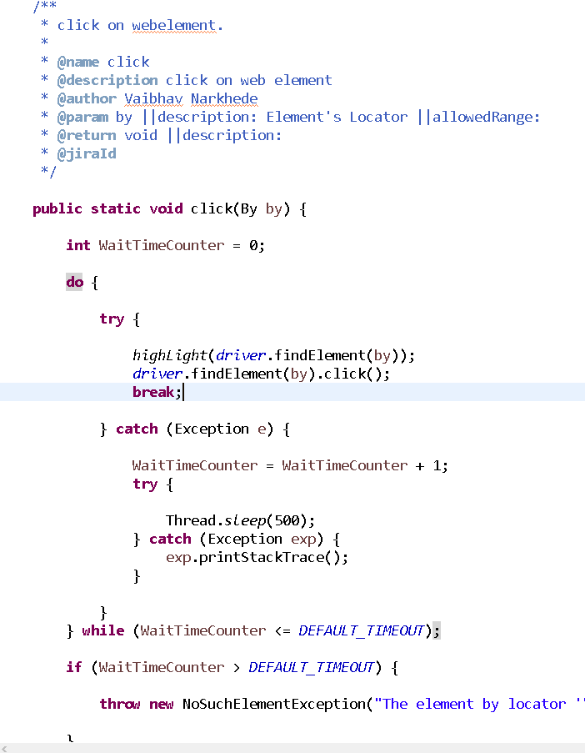
Base Page Class - Snapshot
Constructor – Setting up Driver, prop, DB object , logger object
Rewrite each operation after incorporating synchronize technique

Slide 16
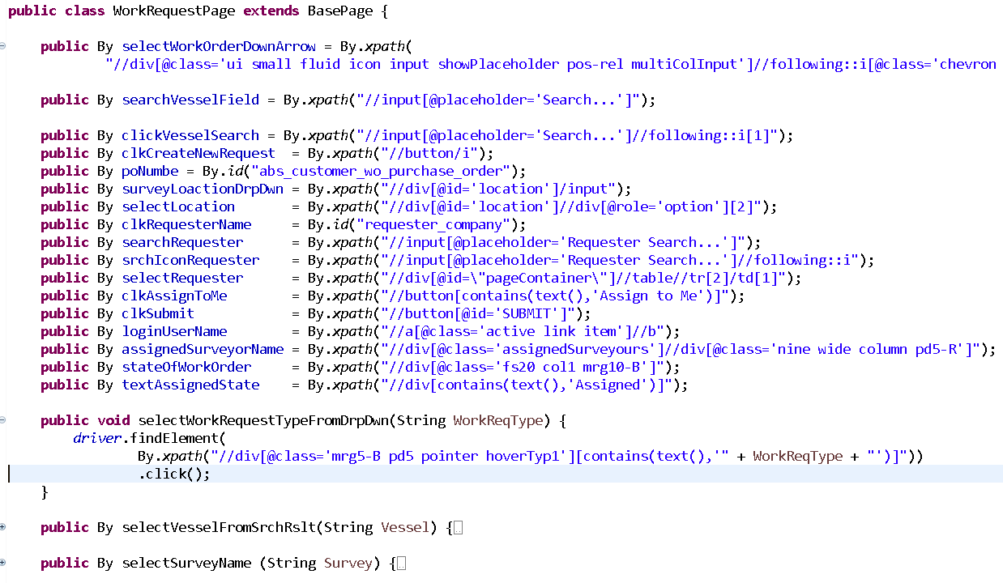
Page Class Sample
Locators
Dynamic Locators

Slide 17
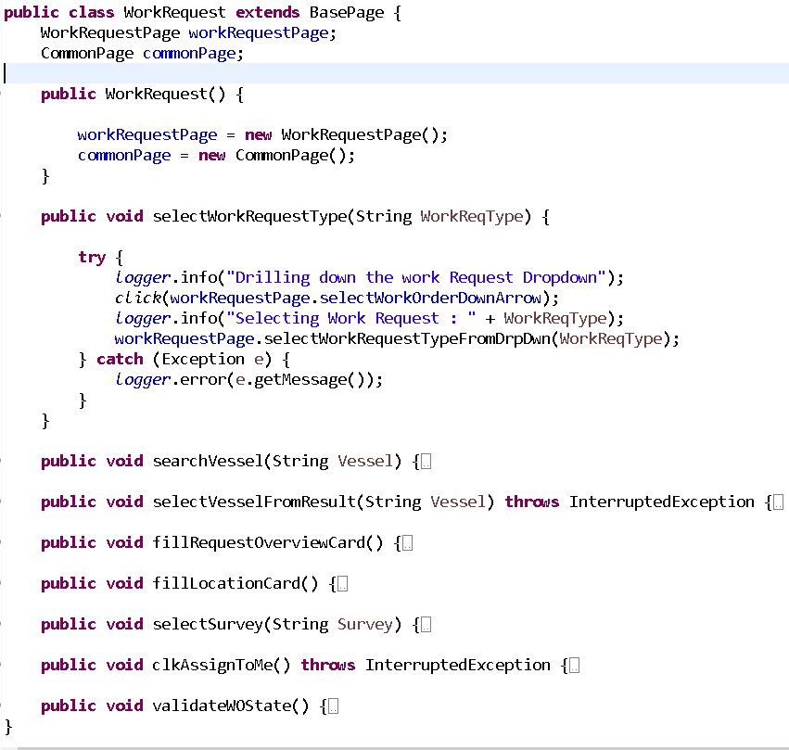
Step Class Sample
KEYWORDS

Slide 18
Framework Architecture

Slide 19
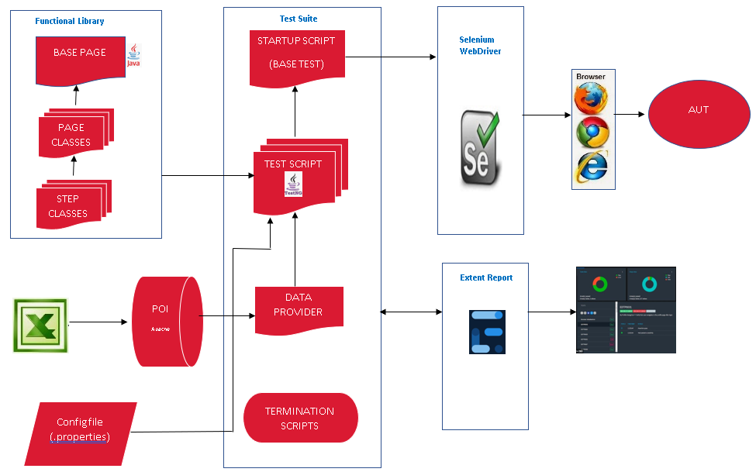
Architecture Diagram

Slide 20
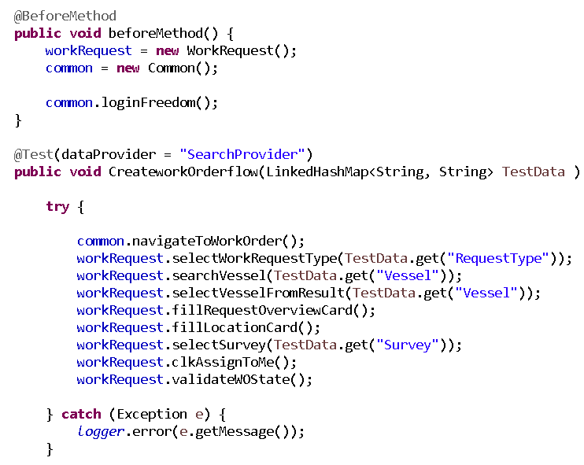
Test Script Sample
Data received from DataProvider Class
Readable Steps

Slide 21
Framework Setup

Slide 22
Framework Setup
DriverLib
Calls
Test Class(Script)
Base Test
Extends
Calls
Util
Calls
Initiate
Step Class
Base Page
Extent Report
Extends
Calls
Page Class
Calls
Extends
Step
Page
Framework

Slide 23
LOGGING & REPORTING

Slide 24
Reporting
Logging & Reporting can be achieved by Aventstack Extent Report.
Reports will be stored in extent-report folder with date +timestamp.
Strict standards have to be adhered to logging.
If the standards are followed, it will allow to
Debug the failure efficiently
Analyze the readable report with additional stats in pie chart format

Slide 25
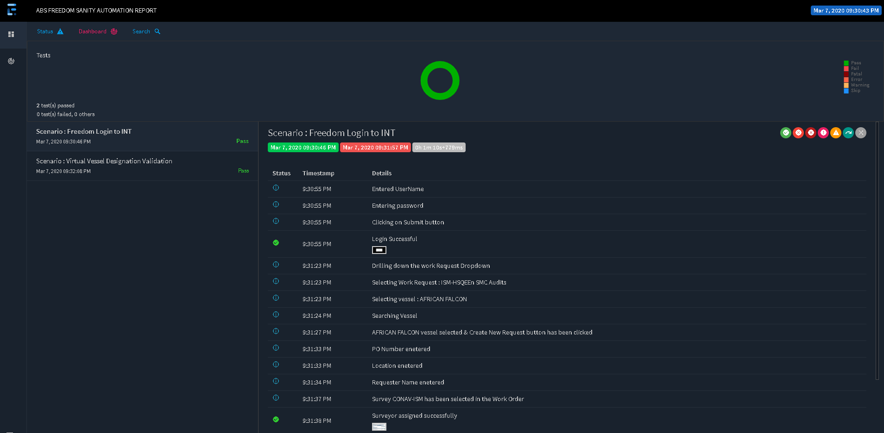
Extent Report - Sample
Status
Steps
Scenarios
C:\Users\VNarkhede\eclipse-workspace\WorkReq\test-output\ABSExtentReport-07-03-2020 9-30-43.html

Slide 26
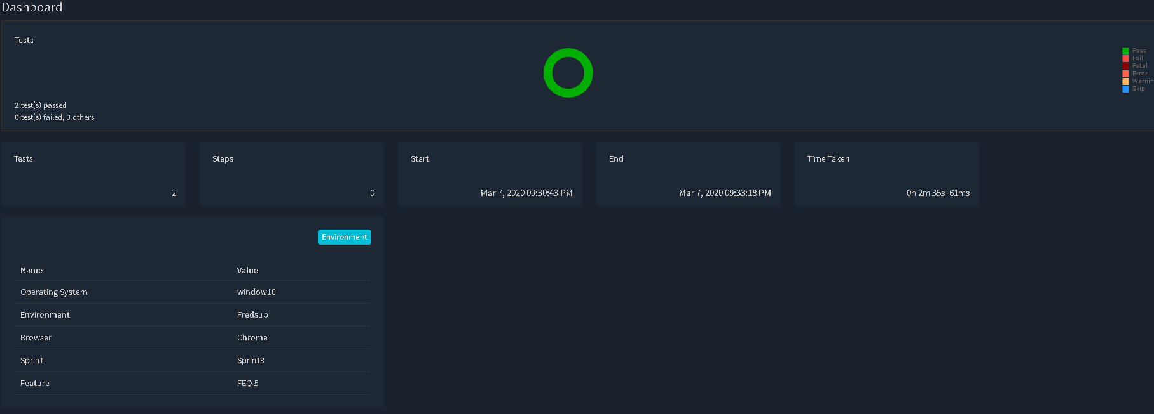
Extent Report - Sample
Dashboard
Execution Information

Slide 27
Synchronization
There are 4 types of synchronization techniques are used in framework
Unconditional: Waits certain amount of time and then proceed further. Unnecessary waiting time even though the application is ready.
Thread.Sleep(1000);
Conditional Synchronization:
Implicit Wait: Tells WebDriver to poll the DOM for a certain amount of time when trying to find an element or elements if they are not immediately available.
driver.manage.TimeOuts.implicitwait(6,Timeunit.SECONDS);
Explicit Wait: Waits for a certain condition to be satisfied until the specified timeout period.
/*Explicit wait for state dropdown field*/
WebDriverWait wait = new WebDriverWait(driver, 10);
wait.until(ExpectedConditions.visibilityOfElementLocated(By.id("statedropdown")));
Fluent Wait: It can define the time to wait for a condition, as well as the frequency with which to check for the condition and also to ignore specific types of exceptions.
Wait<WebDriver> wait = new FluentWait<WebDriver>(driver)
.withTimeout(30, TimeUnit.SECONDS) //Wait for the condition.
.pollingEvery(5, TimeUnit.SECONDS) // Check for condition with interval of 5 seconds.
.ignoring(NoSuchElementException.class); //Ignore the NoSuchElementException.
.until(ExpectedConditions.elementToBeClickable(By param)); //Condition to check.

Slide 28
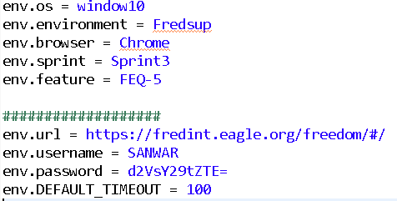
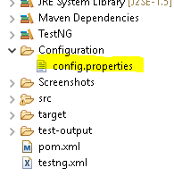
Configuration
Configuration property are maintained in properties file under configuration folder.
Tester has to update the .Properties file before execution.
Properties File:

Slide 29
Encryption
Base64 encryption technique used to encrypt all the password used in script.
Decryption of password occur at run time using Base64 classes.
Properties File:

Slide 30
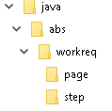
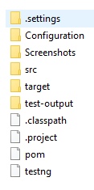

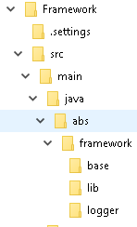
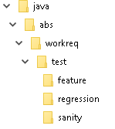
SVN & Directory Structure
SVN Directory
TestwareSel – SVN directory
Application/Epic level folder will be created
Maven project (App) will be saved under corresponding App folder.
http://houbsrc01.eagle.org/svn/mxrepo/ABS_Freedom/branches/QA_Automation/TestwareSel
Checkout
Check-in
C:/TestwareSel/App/Appname
C:/TestwareSel/Common

Slide 31
Agile(Scrum) Compatibility
Page class can be prepared during development of feature in same sprint.
Corresponding step class and test scripts can be prepared in upcoming Sprint.
Regression lib can be maintained gradually with each sprint.
Regression in each sprint will ensure that earlier sprint feature are not broken due to current change.
Sprint-1
Page Class preparation in Dev environment
Sprint-2
Sprint-1 feature , Step classes and Test script preparation and execution
Sprint -2 feature page class preparation in Dev env
Sprint-3
Sprint-2 feature , Step classes and Test script preparation and execution
Sprint -3 feature page class preparation in Dev env

Slide 32





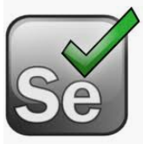
Continuous Integration
Execution of scripts controlled by testNG.xml.
plugin maven-surefire-plugin is used to configure and execute the tests..
Jenkins can trigger the testNG.xml through Maven.
Dev Team
Triggered build
Reports
Triggers
Triggers
Jenkins
Triggers
Operation

Slide 33
Demo / Q&A

Slide 34
Thank You
www.eagle.org

